Slide 1

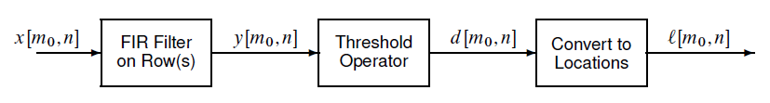
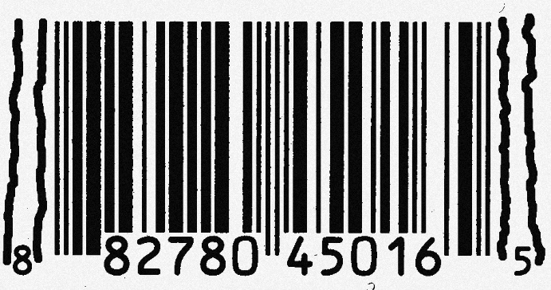
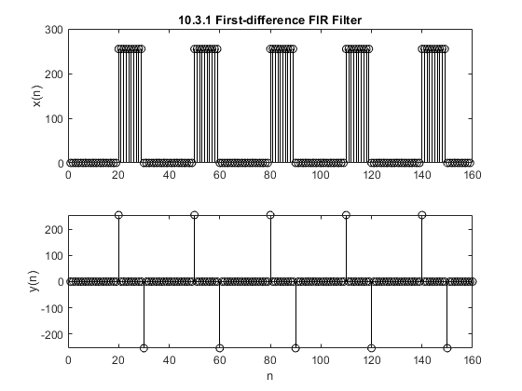
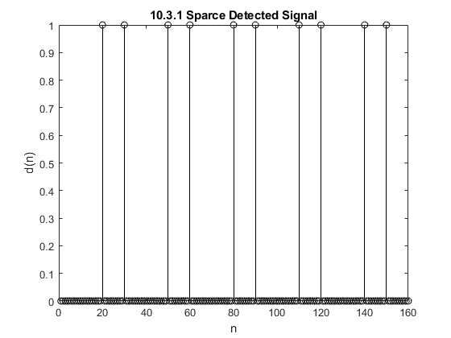
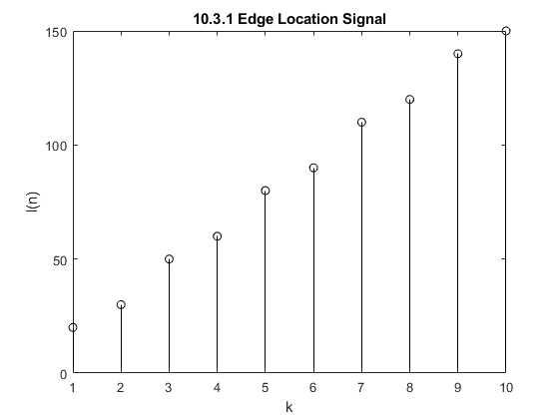
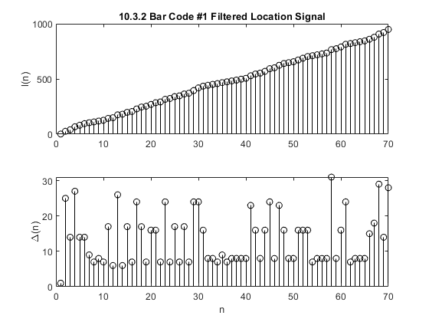
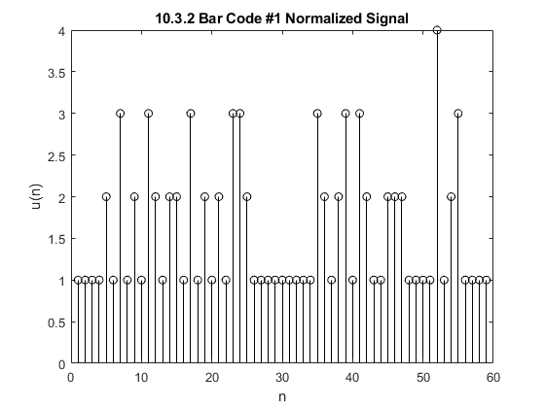
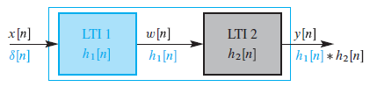


FIR Filters
Aaron Blanchard¹, Antonio Santos Aguilera¹, Caina Fernandes¹, Jason Porter¹
College of
Engineering
¹Department of Electrical and Computer Engineering, University of Utah
Instructor: Neda Nategh
Introduction
Audio Effect
FIR filters are frequency-selective filters utilized in a variety of digital signal processing applications in which linear-phase integrity is important. Because FIR filters are computationally expensive compared to IIR filters, designing efficient filtering algorithms can be critical in applications with limited memory storage or a low tolerance for latency. However, FIR filters are inherently stable systems and do not introduce distortion into filtered signals. This is why FIR filters are often used in audio and image processing. This project investigates FIR filters commonly used in audio effect manipulation, signal restoration, and image edge detection.
Methods
Image Restoration
The following FIR filtering techniques were implemented in this research:
Echo:
A linear-phase shift that generates a signal delay with a relative magnitude to the original signal. This phenomenon produces echoes and reverberations in audio signals, as well as “ghosts” in images.
Cascading Systems:
The process of sequentially convolving two FIR filters on the same signal.
Deconvolution:
A signal processing technique used to rectify an undesired convolution. This is useful in image restoration.
First-Difference Filter: $y\left(n\right)=x\left(n\right)−x(n−1)$
A filter designed for detecting significant fluctuations in a signal. This concept is known as edge detection and can be used in many image processing applications including bar code scanning.
Edge Detection
Process
Bar Code Decoding
1
2
3
4
$$h\left(n\right)=\{1,−1\}$$
1
3
4
2
Analysis
References
J. G. Proakis and D. G. Manolakis, “Implementation of Discrete-Time systems,” in Digital Signal Processing, Hoboken, NJ: Pearson Education, 2021.
McClellan, J., Schafer, R. and Yoder, M., n.d. DSP first. 2nd ed.

